Slide 1

AI-DRIVEN API SECURITY MONITORING, INTELLIGENT THREAT DETECTION,
AND AUTOMATED INCIDENT RESPONSE PLATFORM USING LARGE LANGUAGE MODELS
SOA Project Review-2
Thursday, September 24, 2026
 | Under the Guidance of Dr. Srikanth Cherukuvada Assistant Professor, Department of Computer Science and Engineering, KLH CSE Bowrampet Campus
Team Members T. Aashritha Reddy - 2420030719 S. Indu – 2420030710 N. Sai Pragathi - 2420030672

Slide 2
Outline of Research Work
Focus
Introduction
Literature Survey
Challenges
Research Objectives
Conclusion & Future Work
References
Publications Details

Slide 3
Problem Statement
Existing API security solutions often rely on predefined rules, signatures, and isolated monitoring mechanisms, making it difficult to detect evolving, context-dependent, and previously unseen threats in real time. The lack of intelligent event correlation and contextual analysis can result in false alerts, delayed investigation, and inefficient incident response.
Therefore, there is a need for an AI-driven API security platform that continuously monitors API activity, intelligently identifies threats using behavioral analysis and Large Language Models, evaluates risk, and automatically initiates appropriate incident-response actions.

Slide 4
Objectives
To develop a real-time API security monitoring platform.
To detect abnormal and malicious API behavior.
To use Large Language Models for contextual security-event analysis.
To correlate API traffic, authentication events, logs, and threat indicators.
To generate dynamic risk assessments for detected threats.
To automate appropriate incident-response actions.
To provide explainable security insights and incident reports.

Slide 5
Literature Survey
Authors | Title of the Paper | Methodology | Inferences | Limitation/Future work
Baye et al. [2021] | API Security in Large Enterprises: Leveraging Machine Learning for Anomaly Detection | SVM-based binary classifier on API traffic features (bandwidth, requests per token) | Effectively distinguishes normal from abnormal API traffic using lightweight ML on traffic-level features | Limited to traffic/volume-based features; lacks semantic understanding of request content
Palma et al. [2025] | Leveraging Large Language Models for Scalable and Explainable Cybersecurity Log Analysis | Benchmarked open LLMs (Qwen2.5, Gemma3, Llama3.2) vs XGBoost/Random Forest/LightGBM with domain-specific prompt engineering | LLMs (F1 = 0.928) substantially outperform traditional ML (F1 = 0.555) and generate explainable, human-readable outputs | High compute cost for larger models; future work on real-time SOC pipeline integration
Ismail et al. [2025] | Toward Robust Security Orchestration and Automated Response in SOCs with a Hyper-Automation Approach Using Agentic AI | Agentic LLM-based SOAR generating AI-driven automation workflows aligned with the SANS PICERL framework | Improves flexibility and scalability of automated incident response over rigid no-code SOAR playbooks | Needs further validation on production-scale SOC workloads; future work on trust/safety of autonomous actions

Slide 6
Research Gap Identification
Existing API security systems are heavily dependent on predefined rules and signatures.
Conventional systems have limited contextual understanding of complex API behavior.
Security events are often analyzed independently rather than correlated across multiple requests and sessions.
Many systems focus on detection and alerting rather than automated response.
Existing approaches may struggle with evolving and previously unseen attack patterns.
There is limited integration of LLM-based contextual reasoning with real-time API security monitoring.
There is a need for an integrated framework combining monitoring, intelligent detection, risk assessment, explainability, and automated response.

Slide 7
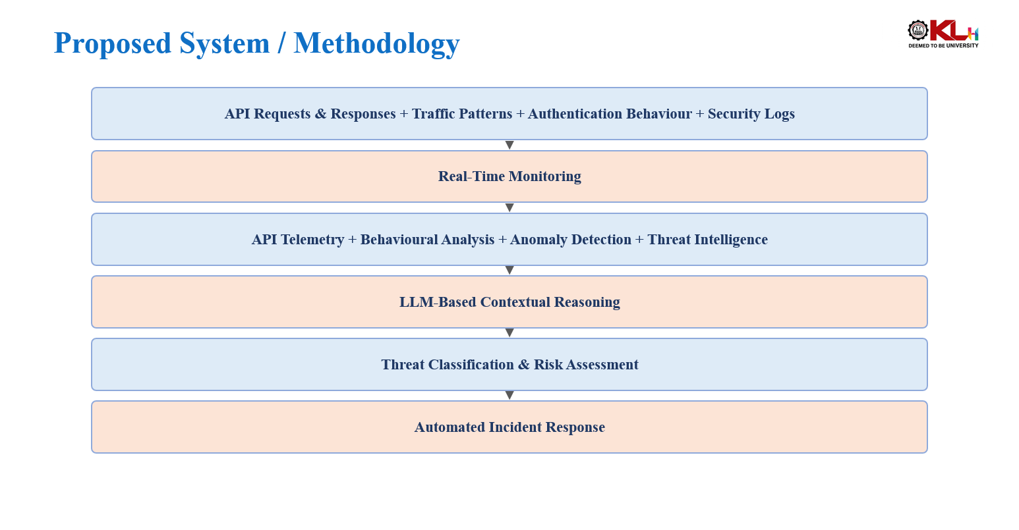

Slide 8
Innovation, Creativity
Unifies real-time API monitoring with LLM-driven contextual threat analysis.
Incorporates intelligent multi-event correlation across sources.
Provides explainable threat reasoning rather than opaque pattern matching.
Performs adaptive risk assessment of detected threats.
Integrates automated response within the same platform as detection.
Detection and response are unified within a single cohesive platform, rather than treated as separate, loosely connected components as in conventional systems.

Slide 9
Novelty
Real-time API monitoring detects suspicious activities continuously.
AI-based behavioral analysis identifies abnormal and evolving attack patterns.
LLM integration understands the context of security events and explains threats clearly.
Threat correlation connects multiple security events to detect complex attacks.
Dynamic risk assessment combines anomaly scores, threat indicators, and historical behavior.
Automated response takes actions such as alerting, rate-limiting, blocking, and session revocation.
Adaptive security responds according to Low, Medium, High, and Critical risk levels.
Unified and proactive platform combines detection, analysis, explanation, risk assessment, and response.

Slide 10
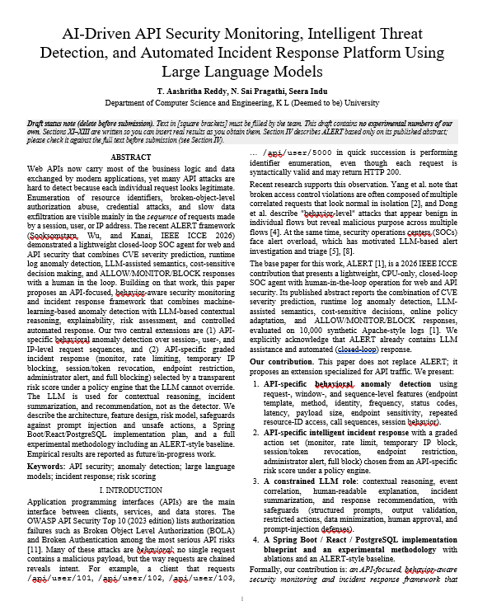
Base Paper

Slide 11
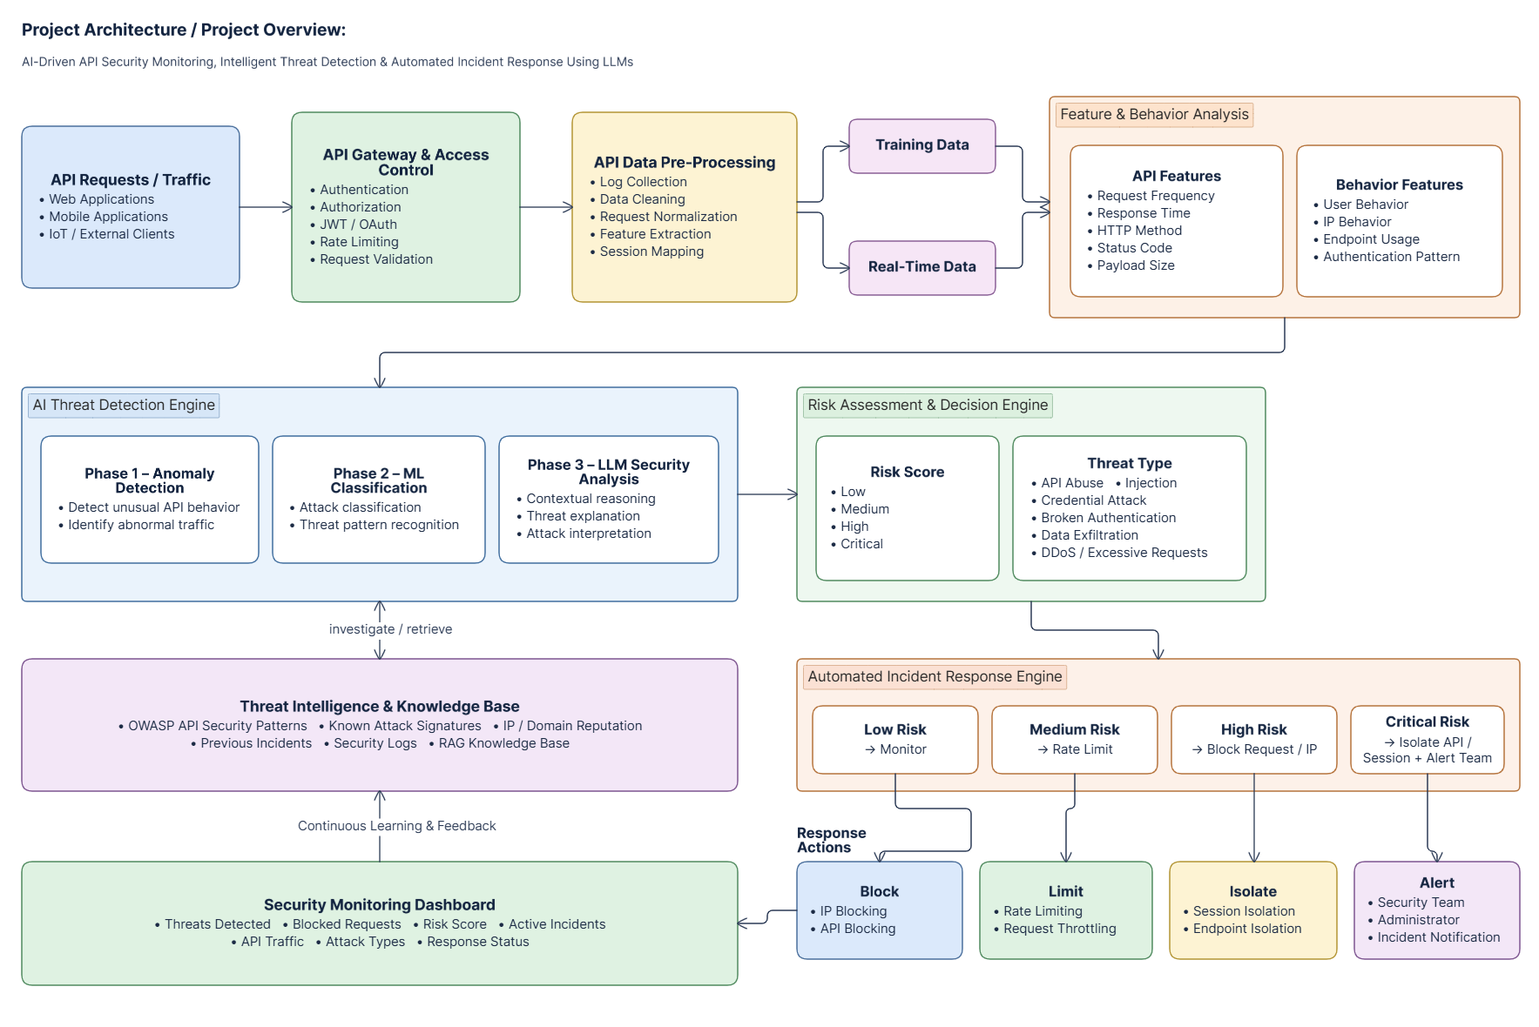
Project Architecture

Slide 12
Feasibility and Project Plan
Technical Feasibility
API monitoring and logging
Anomaly and behavioral detection
LLM integration
Security-event processing
Risk-scoring mechanism
Incident-response automation
Security dashboard
Operational Feasibility
Continuous monitoring
Centralized security visibility
Reduced manual investigation
Faster incident response
Research Feasibility
API security datasets/logs
Simulated attack scenarios
Security event generation
Performance evaluation using detection and response metrics
Project Timeline
Phase 1 | Phase 2 | Phase 3 | Phase 4
Problem Identification & Requirement Analysis Literature Survey & Research Gap Identification | System Architecture & Technology Selection API Monitoring & Data Collection Threat Detection & Anomaly Analysis | LLM-Based Security Analysis Risk Scoring & Threat Classification Automated Incident Response Module | Dashboard & System Integration Testing, Evaluation & Performance Analysis Documentation & Final Presentation

